Slide 1

WELCOME

Slide 2
HOSPITAL MANAGEMENT SYSTEM
Under Guidance Of
POOJA MEHTA
SUBMITTED BY –
1. Madhavan Thati
2. Chakali Nagarjuna
3. Divakar R
4. Sri Varsha
5. Naveen Ravirala
6. Manchala Eswar

Slide 3
INTRODUCTION
A hospital management system is a software application that helps hospital administrators manage their daily operations more efficiently. It typically includes modules for managing patient records, doctor records ,appointments, billing, prescription and other hospital-related functions.
A Spring Boot project is a popular framework for building Java-based web applications. It provides a streamlined development experience and eliminates the need for complex XML configuration files. Instead, it uses an opinionated approach to configuration and relies on sensible defaults to minimize boilerplate code.

Slide 4
TECHNOLOGIES USED
Spring Boot
MySQL
Postman
Angular

Slide 5
REQUIRED SPECIFICATIONS
Hardware Configuration –
Operating System: Windows 10
Solid state drive (SSD) : 512 GB
RAM: 4GB
Software Configuration –
Software IDE: Spring Tool Suite
Language: Java
Front End: Angular
Back End: MySQL, Postman

Slide 6
SPRING ANNOTATIONS
@RestController : Spring RestController annotation is used to create RESTful web services using Spring MVC. Spring RestController takes care of mapping request data to the defined request handler method. Once response body is generated from the handler method, it converts it to JSON or XML response.
@Autowired: The @Autowired annotation provides more fine-grained control over where and how autowiring should be accomplished.
@RequestMapping : @RequestMapping is one of the most common annotation used in Spring Web applications. This annotation maps HTTP requests to handler methods of MVC and REST controllers.
@Entity:The Entity annotation specifies that the class is an entity and is mapped to a database table.

Slide 7
SPRING ANNOTATIONS
@RequestBody: The @RequestBody annotation is applicable to handler methods of spring controller. spring should deserialize a request body into an object.
@OneToOne Mapping: The @OneToOne JPA annotation is used to map the source entity with the target entity, Hibernate maps the tables in your database to the Entity classes in your application.
@ ManyToOne Mapping: @Many-to-One mapping means that many instances of this entity are mapped to one instance of another entity.

Slide 8
SPRING ANNOTATIONS
@Table: The Table annotation is used to create a table in database.
@JoinColumn: @JoinColumn is used to specify a column for joining an entity association or element collection.
@PutMapping :@PutMapping is used for update the records.
@PostMapping: @PostMapping is used to create a resource Mapping.
@GetMapping: @GetMapping is used to read all the inserted records.
@DeleteMapping : @DeleteMapping is used to delete the records.
@PathVariable: The Path Variable annotation is used to extract the value from the URL.
@RequestParam: @RequestParam annotation is used to read the form data and bind it automatically to the parameter present in the provided method.

Slide 9
SPRING ANNOTATIONS
@ExceptionHandler:The @ExceptionHandler is an annotation used to handle the specific exceptions and sending the custom responses to the client.
@ControllerAdvice: A controller advice allows you to use exactly the same exception handling techniques but apply them across the whole application, not just to an individual controller. You can think of them as an annotation driven interceptor.
Handles Resource Not Found Exception
Handles Method Argument Not Valid Exception

Slide 10
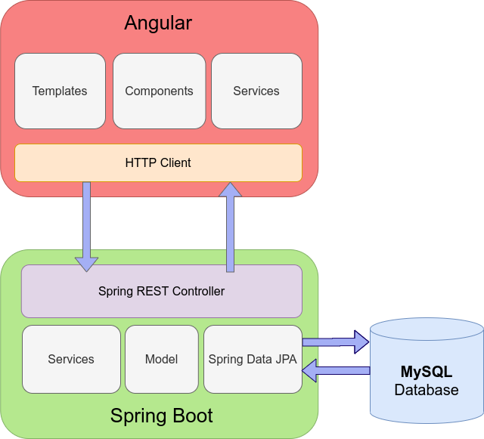
SYSTEM FLOW DIAGRAM

Slide 11
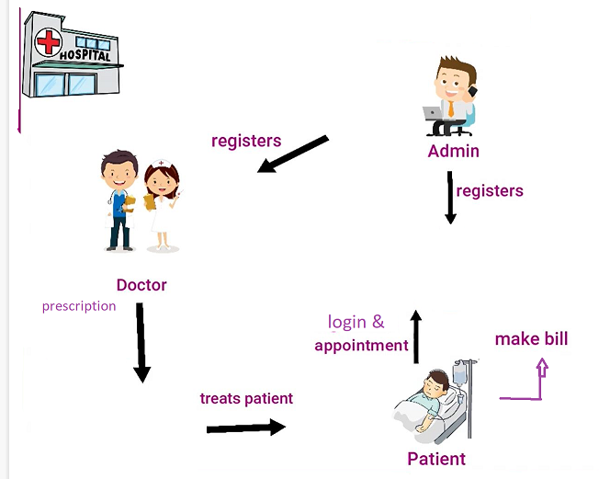
USER FLOW

Slide 12
MODULES
The system contains 3 Modules
ADMIN – Registration, login, manages appointments, doctor list, payments, Edit and delete
DOCTOR – Signup, login and generates prescription
PATIENT - Signup, login, creates appointment and payment

Slide 13
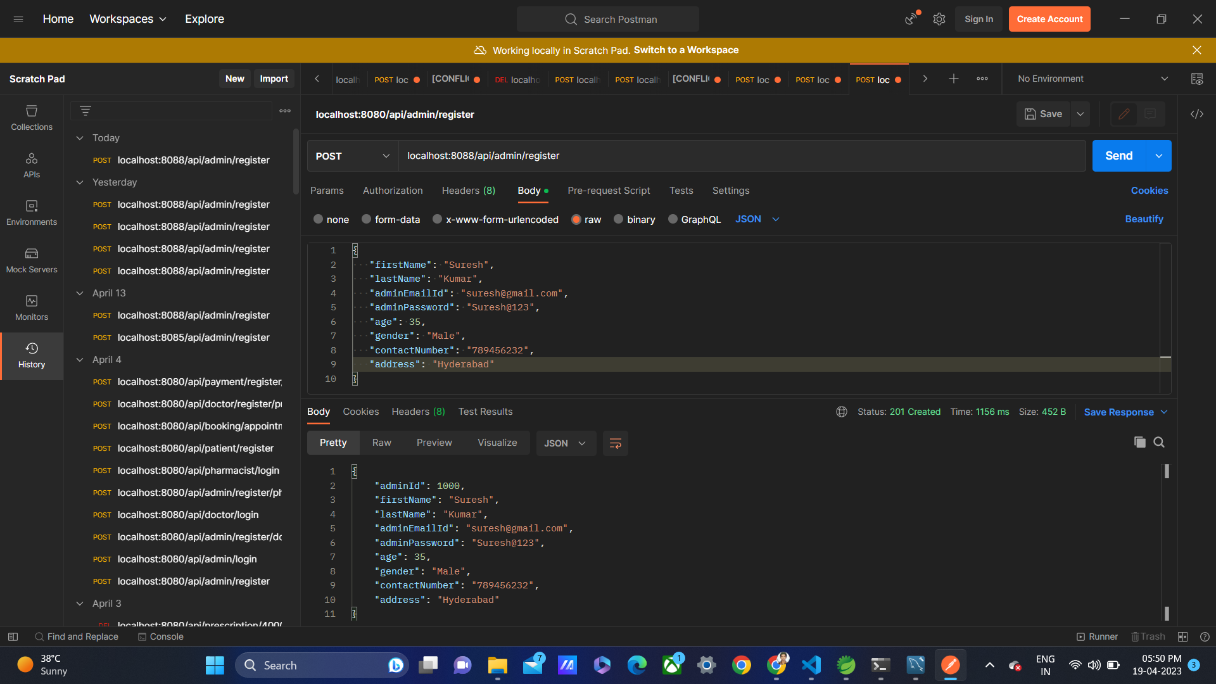
OUTPUT SCREENSHOTS IN POSTMAN
Admin Registration - Admin Login -

Slide 14
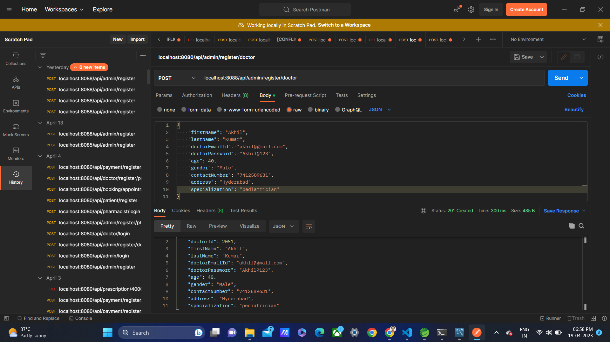
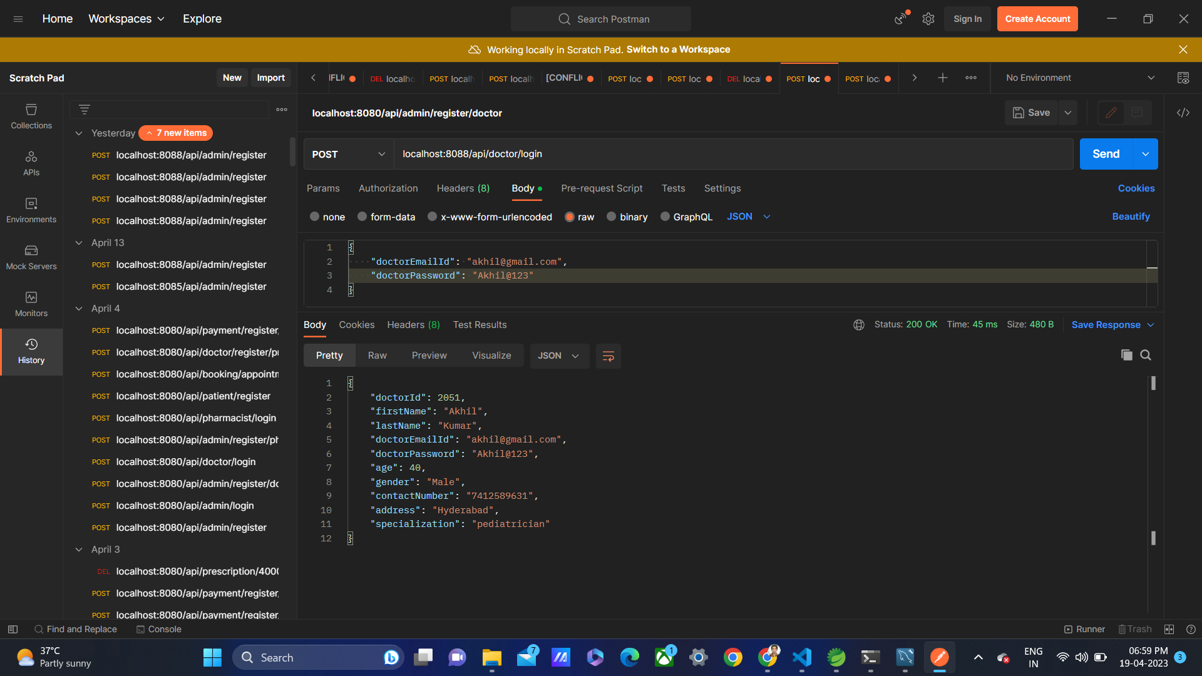
Output -
Doctor Registration- Doctor Login -

Slide 15
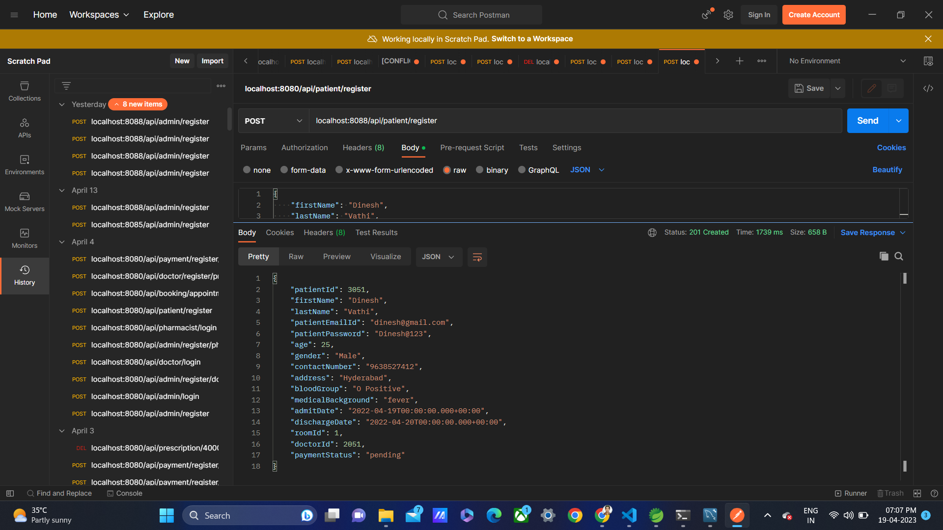
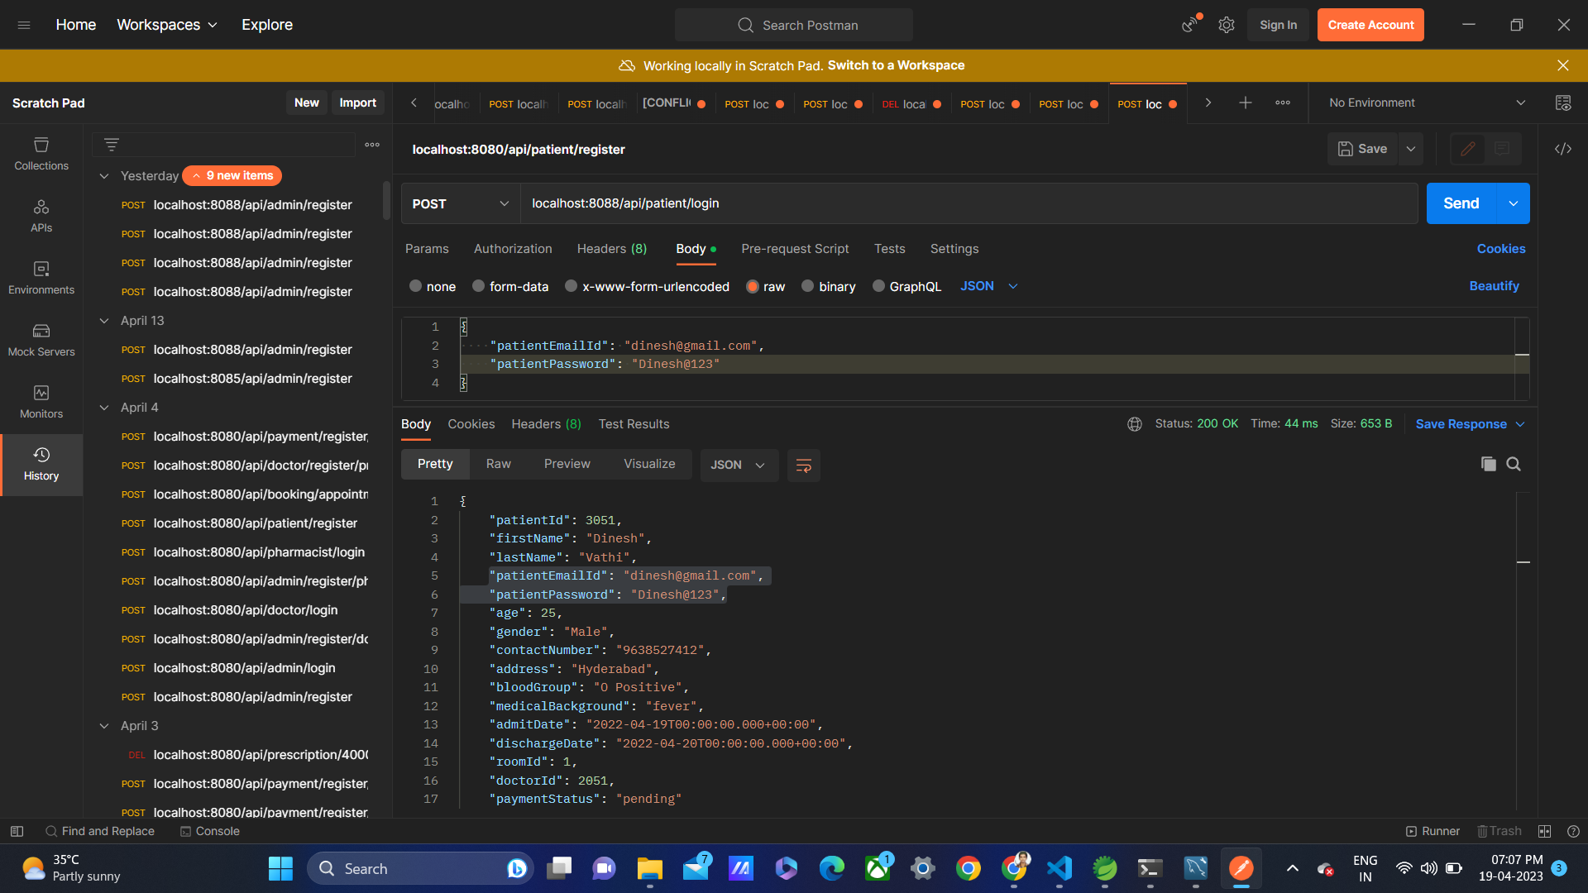
Output -
Patient Registration – Patient Login -

Slide 16
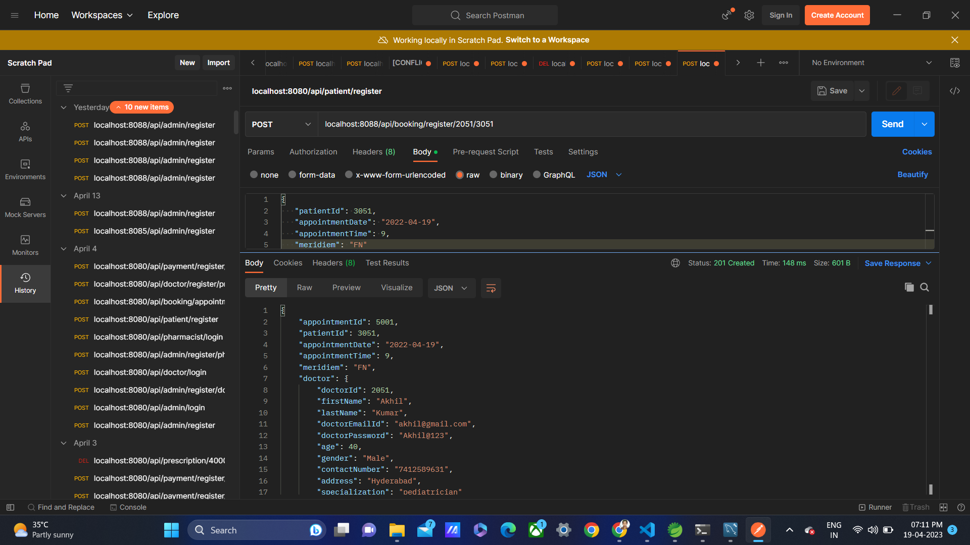
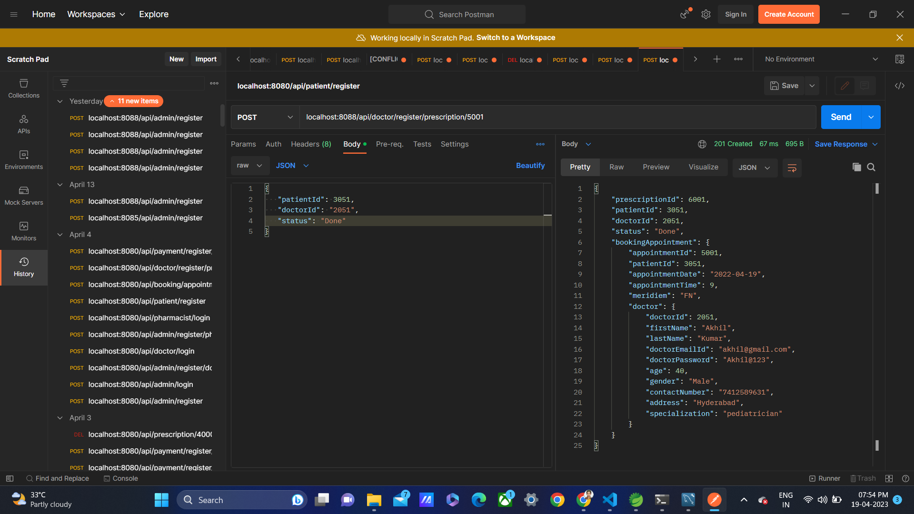
Output -
Booking Appointment – Prescription -

Slide 17
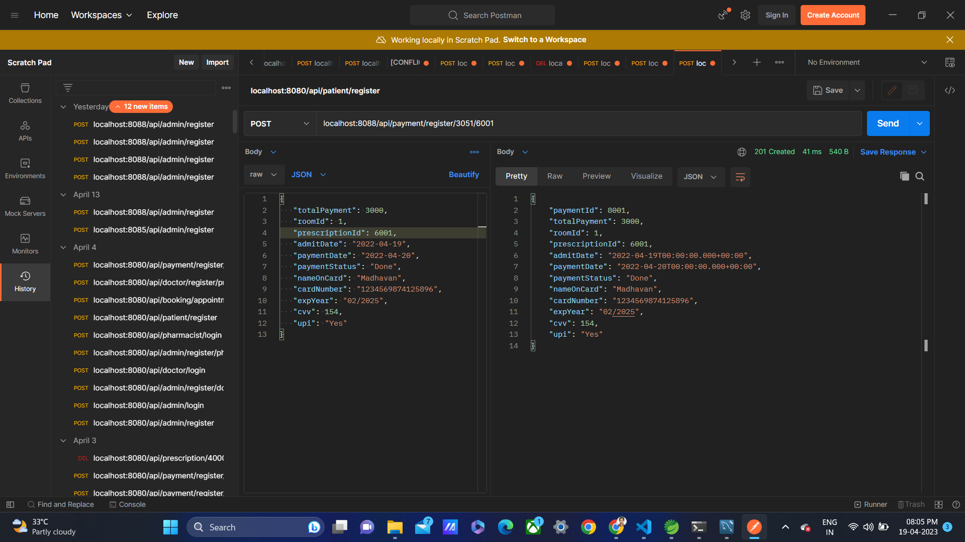
Output -
Payment –

Slide 18
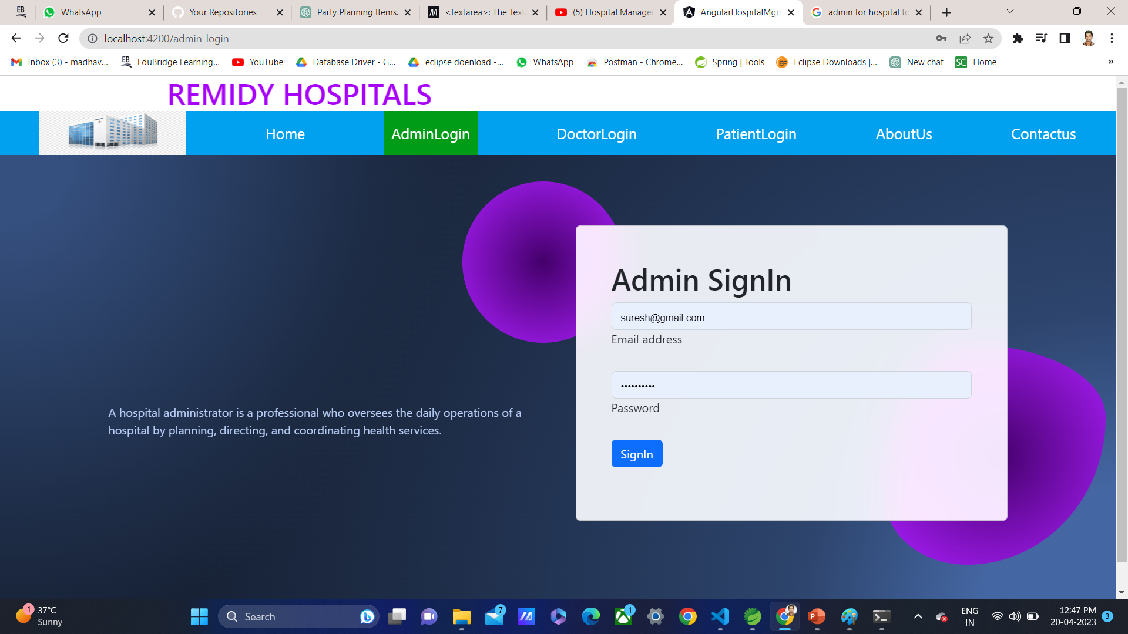
Browser outputs -
Admin Login page –

Slide 19
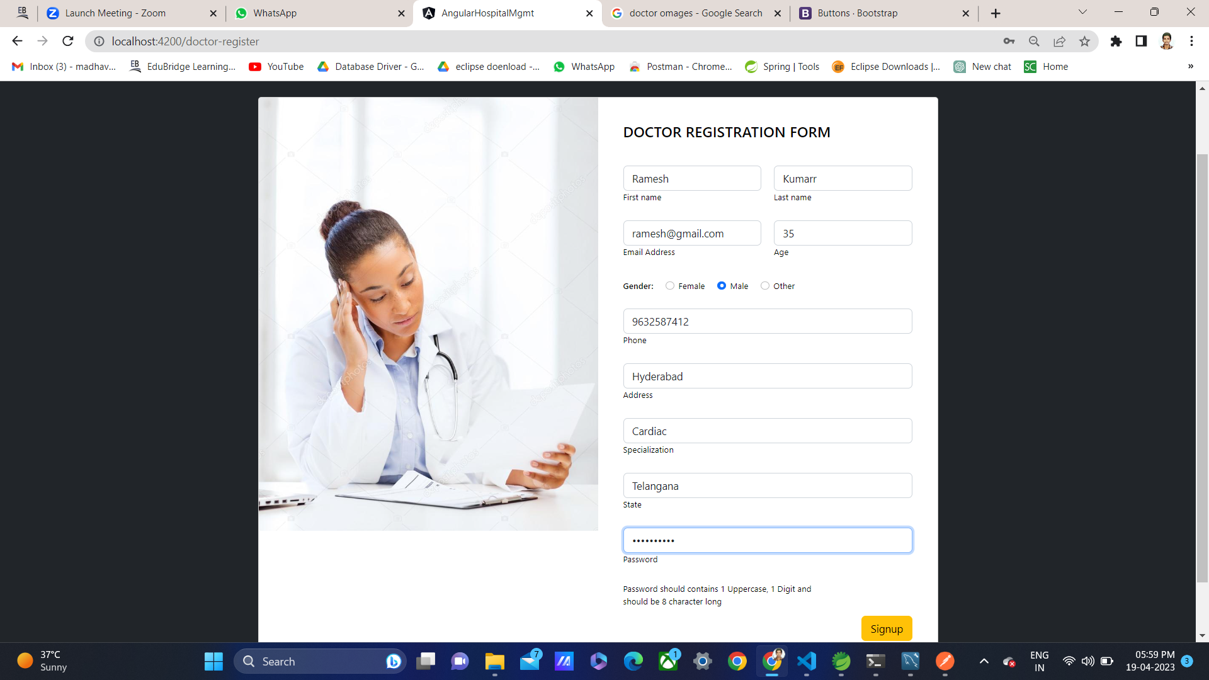
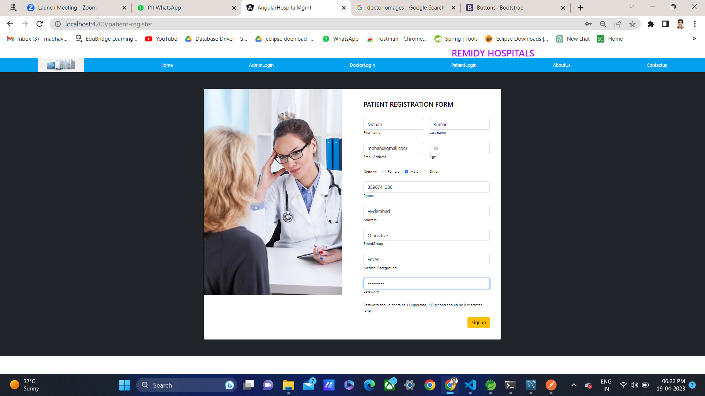
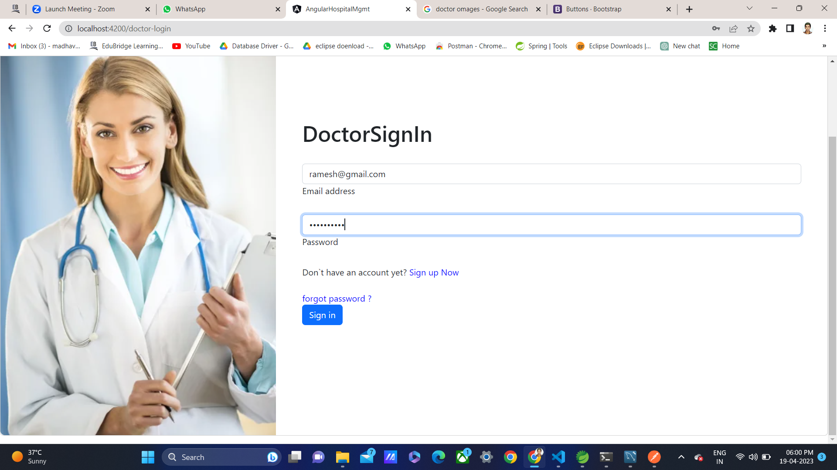
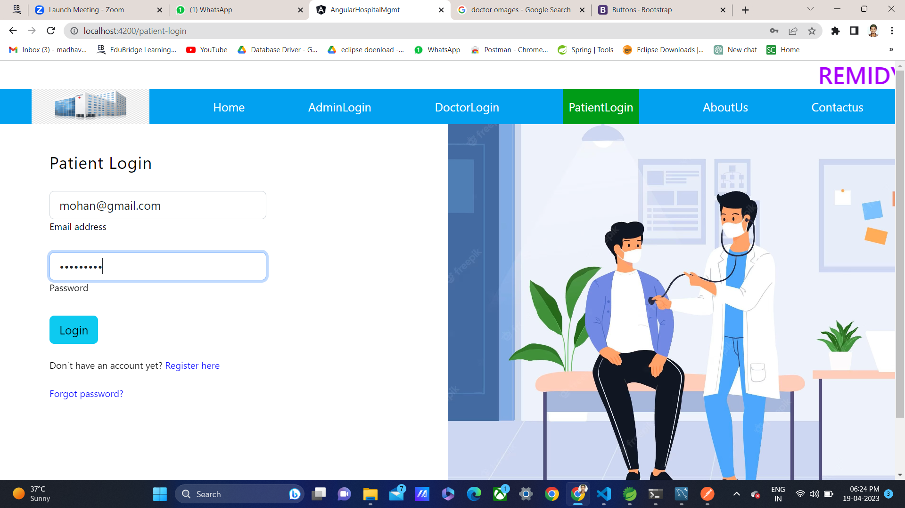
Output
Doctor Signup & Login - Patient Signup & Login -

Slide 20
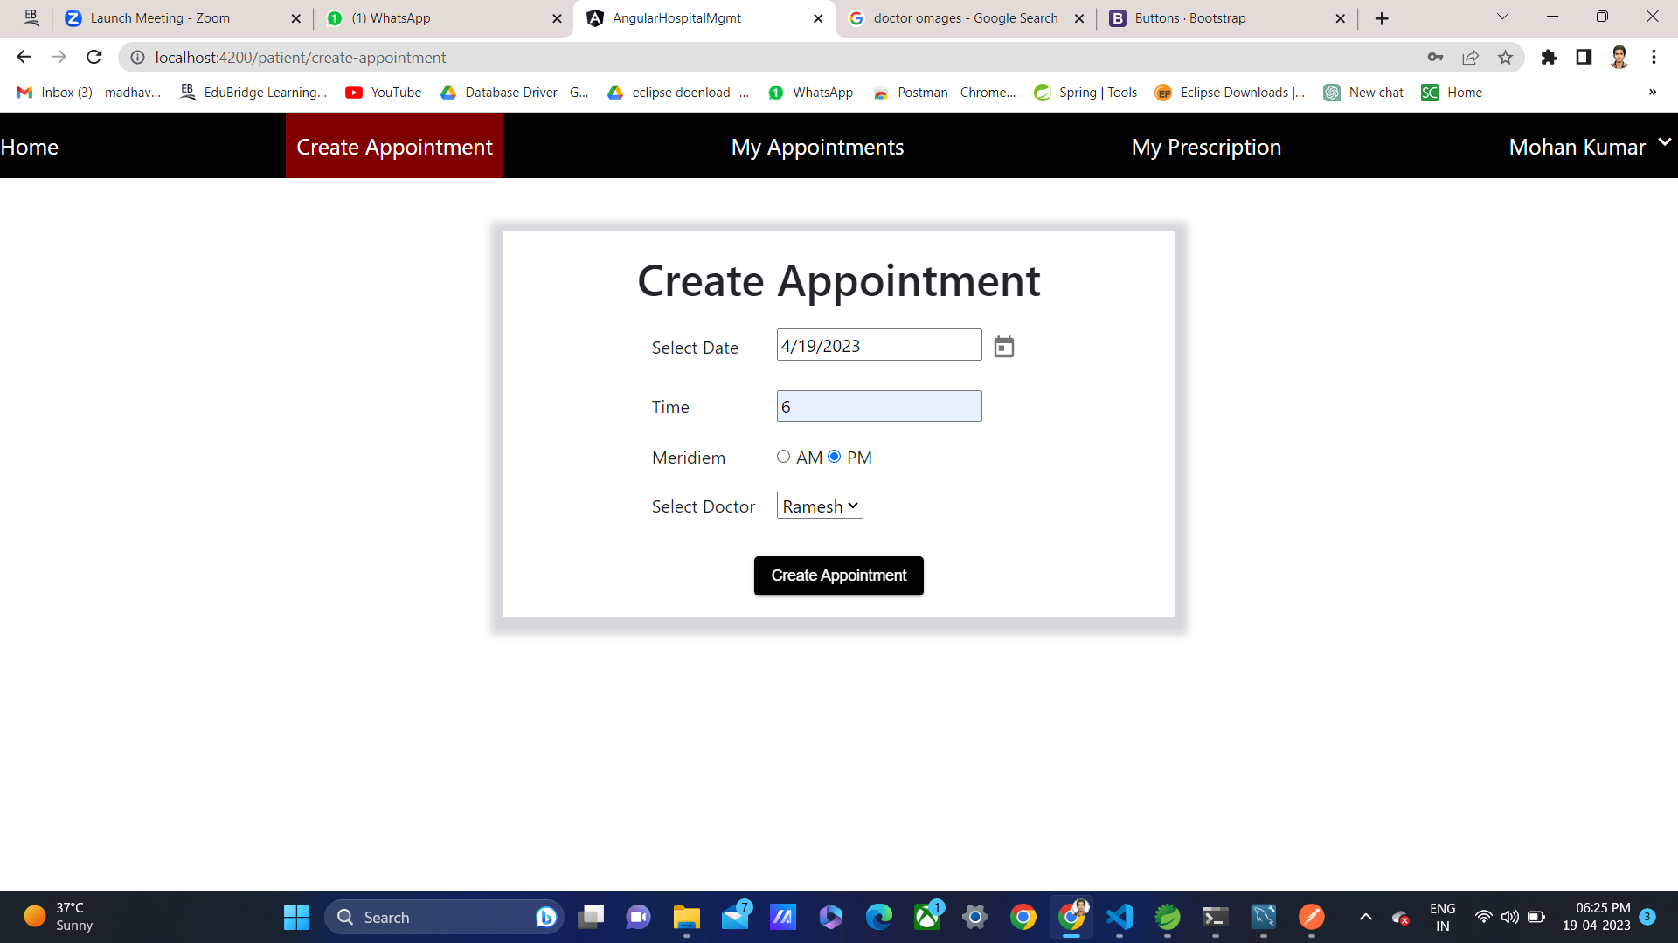
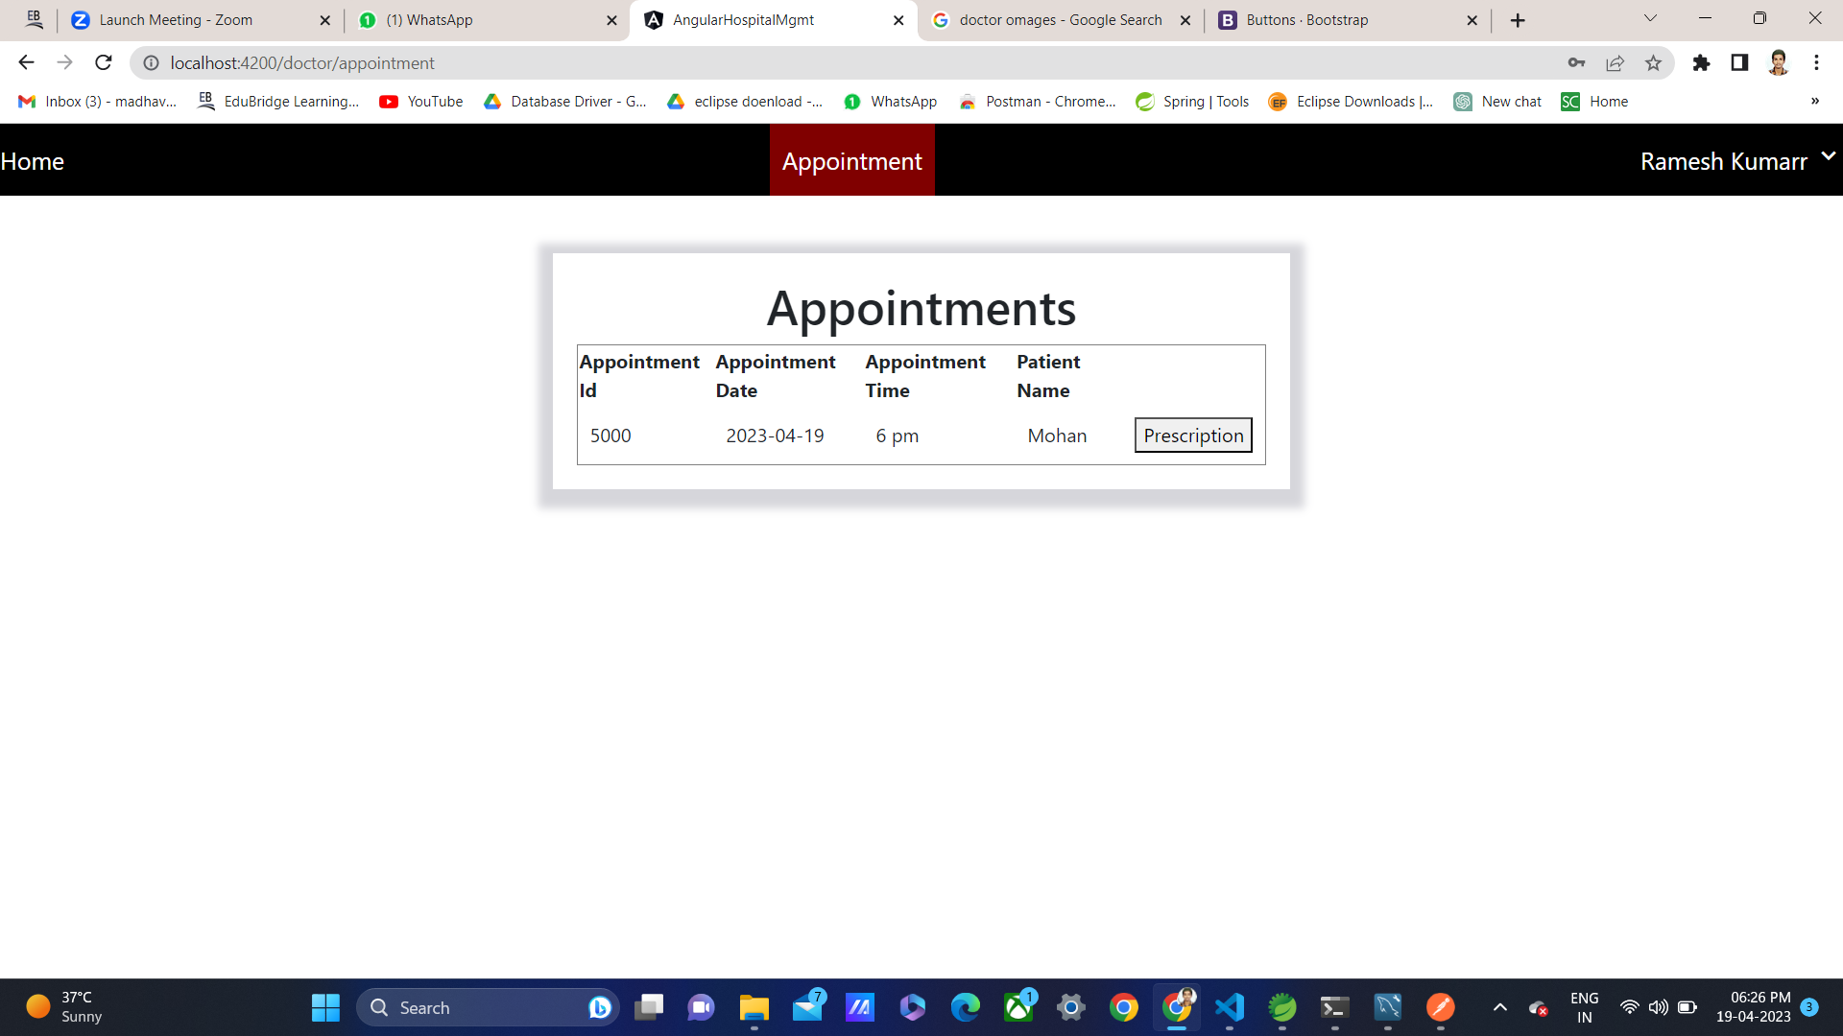
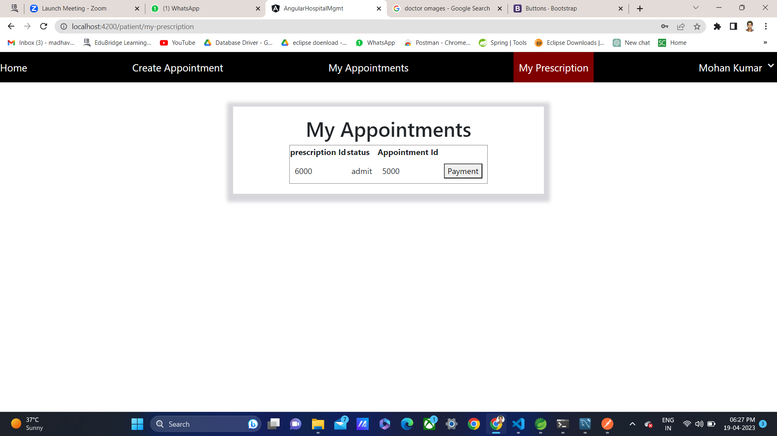
Output
Create Appointment – Prescription - Payment -

Slide 21
Advantages -
Less Paper Work
Costs Reduction
Improves Patient's Experience
Better Collaboration & Communication
Error-free administration. ...

Slide 22
CONCLUSION
Hospital management website developed using Spring Boot can greatly benefit healthcare organizations by providing efficient and effective management of patient data, appointments, billing, and other administrative tasks. The website can also enhance communication between doctors, staff, and patients, allowing for a more streamlined and organized approach to healthcare delivery. By leveraging the features of Spring Boot, the website can be easily deployed and maintained, ensuring a reliable and secure platform for healthcare management. Overall, the hospital management website can improve patient outcomes, increase efficiency, and reduce costs, making it an essential tool for modern healthcare organizations.

Slide 23
THANK YOU

